Slide 1
英語教學分享
Patrick
Notes:
Type your grade.
1

Slide 2
1
2
3
4
5
6
7
8
9
10
11

Slide 3
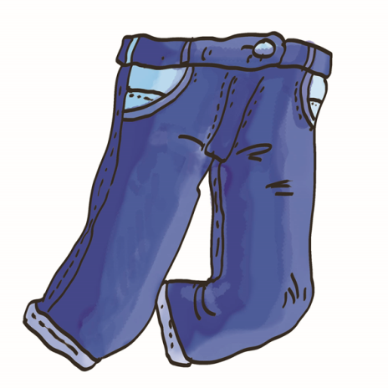
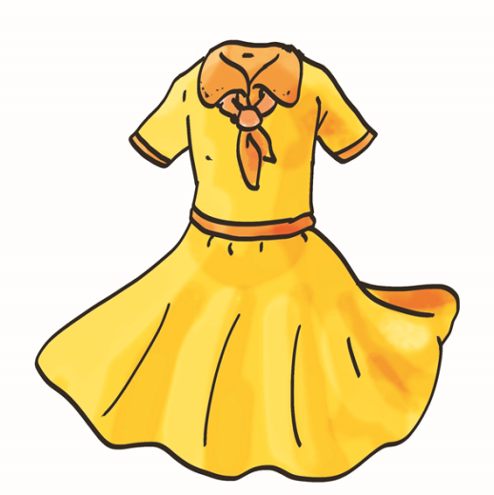
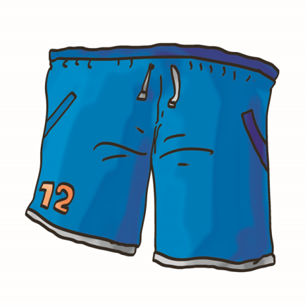
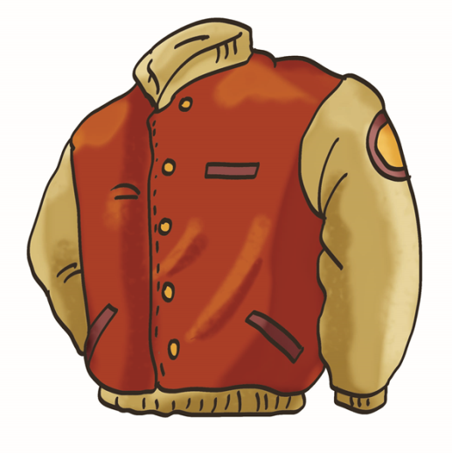
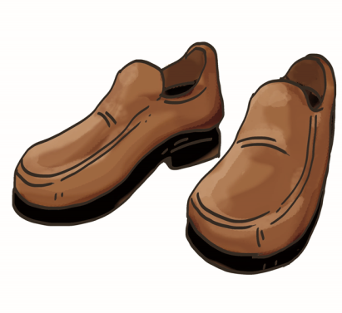
skirt
dress
jeans
shoes
socks
T-shirt
shorts
jacket

Slide 4
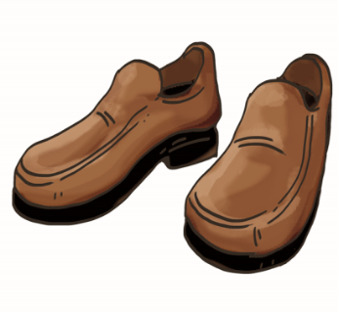

Slide 5
Who Wants To Be A Millionaire? 百萬富翁

Slide 6
Clothing 衣物
Hooray!!

Slide 7
Question 1

Slide 8
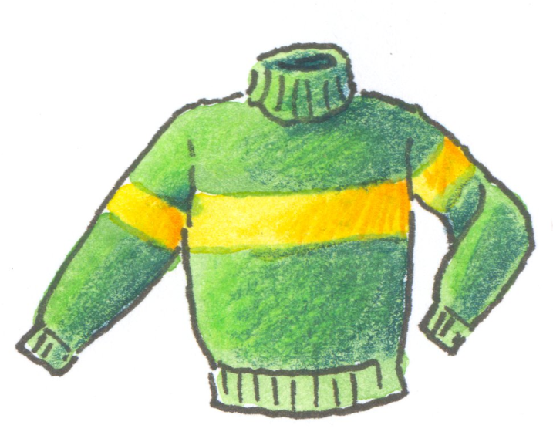
^{A} scarf
^{B} pants
^{C} pullover
^{D} miniskirt

Slide 9
^{A} scarf (圍巾)
^{B} pants (褲子)
^{C} pullover (套頭毛衣)
^{D} miniskirt (迷你裙)

Slide 10
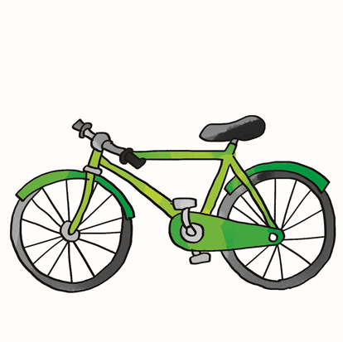
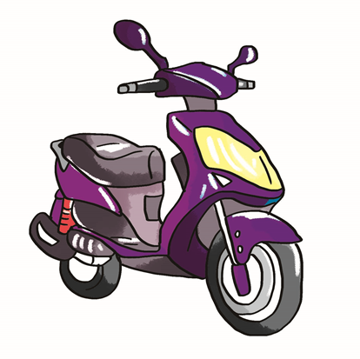
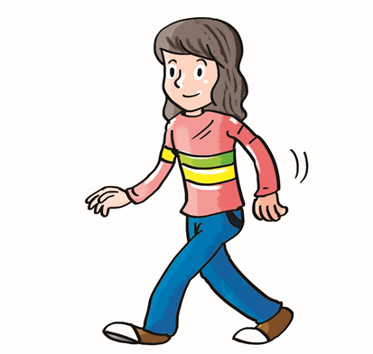

Slide 11
Game Time!
by train
by bus
by bike
on foot

Slide 12
Game Time!
by MRT
by scooter
on foot
by taxi
by bus
by car

Slide 13
The End
Thanks for your listening.

